Slide 1
Semantic Tableaux Method
Crîșmariu Ioana-Teodora
Group 912

Slide 2
Theoretical result
A semantic tableaux is a binary tree associated to a formula U having formulas in its nodes and its nodes and is built as follows:
The root of the tree is labeled with the initial formula.
Every branch of the tree which contains a formula will be extended with a subtree according to the decomposition rule specific to its class
The extension of a branch stops in the following cases:
a) if that branch contains a formula and its negation, the branch is marked as closed using the symbol ⊗.
b) if all the formulas on that branch are already decomposed or if by decomposing the formulas which are not yet decomposed, no new formulas are obtained

Slide 3
A branch of a semantic tableau is called closed if it contains a formula and its negation, otherwise the branch is called open.
A branch is called complete if it is closed or all the formulas on that branch are already decomposed.
A semantic tableau is called closed if all its branches are closed
If a semantic tableau has at least one open branch, the tableau is called open.
A semantic tableau is called complete if all its branches are complete
Remarks:
A closed branch symbolizes inconsistency among the formulas on that branch.
An inconsistent formula has associated a closed semantic tableau.
The set of formulas belonging to a complete and open branch is consistent, meaning it has a model.
A consistent formula has associated a complete and open semantic tableau.

Slide 4
According to Church’s theorem (1936), the problem of validity of a first order formula is undecidable, but is semi-decidable.
If the semantic tableaux associated with the predicate formula ¬U is finite then we can decide whether the formula U is a tautology (closed tableau for ¬U) or not (complete and open tableau for ¬U)
If the semantic tableaux of the predicate formula ¬U is infinite then we cannot decide upon the validity of U.

Slide 5
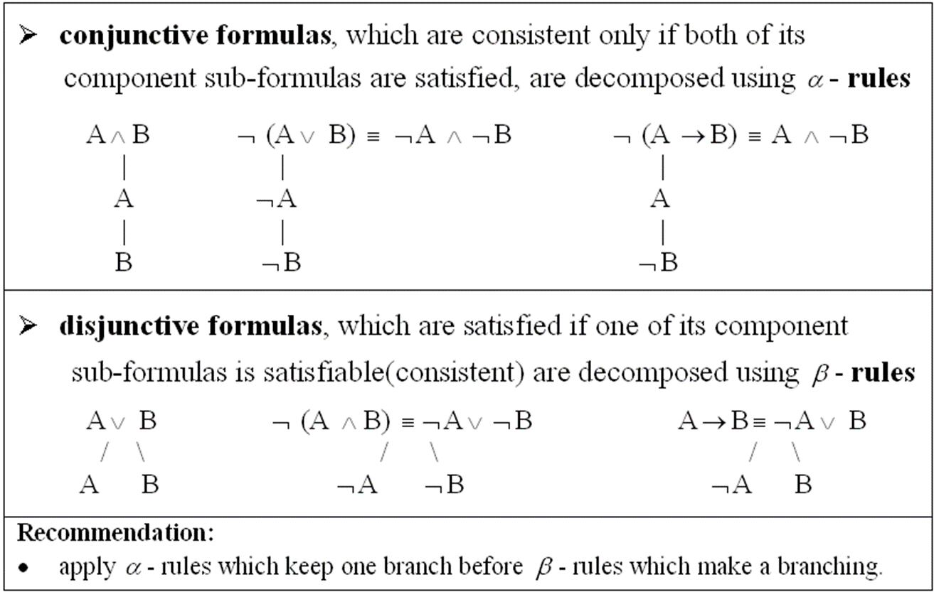
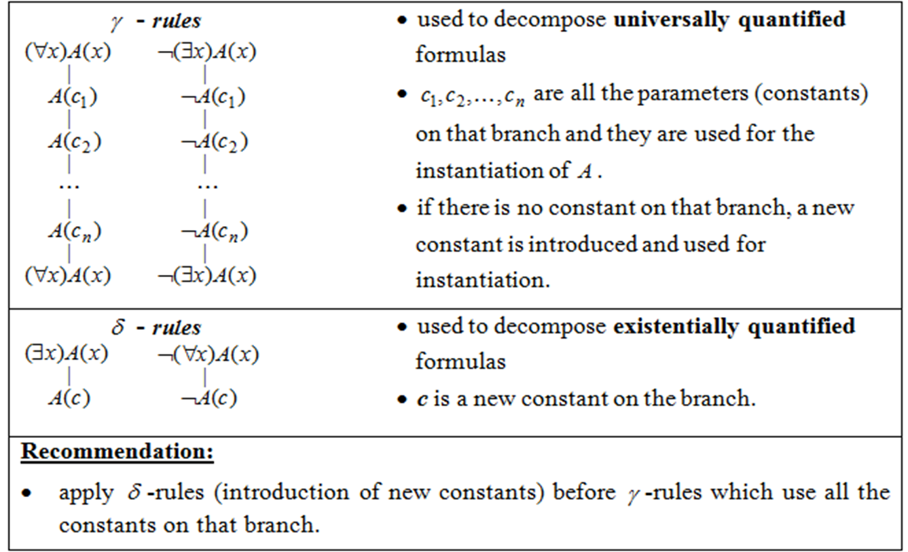
Decomposition rules

Slide 6
Steps
Exercise 6.2: U2 = (∃x)(∀y)P(x,y)↔(∀y)(∃x)P(x,y)
U2 ≡ (∃x)(∀y)P(x,y)→(∀y)( ∃x)P(x,y) ∧ (∀y)(∃x)P(x,y)→ (∃x)(∀y)P(x,y)
For simplicity we will denote by Ua ,Ub the left and right hand side of the conjuction respectively
Ua = (∃x)(∀y)P(x,y)→(∀y)(∃x)P(x,y)
Ub = (∀y)(∃x)P(x,y)→ (∃x)(∀y)P(x,y)
In order to prove the validity of the formula U2, we need to prove the validity of both Ua and Ub. As such, we build the semantic tableaux for ¬Ua and ¬Ub respectively and show that they are closed ( in other words, Ua = (∃x)(∀y)P(x,y)→(∀y)( ∃x)P(x,y) and ¬Ub are inconsistent according to the Theorem of Soundness and Completeness for the Semantic Tableaux Method).

Slide 7
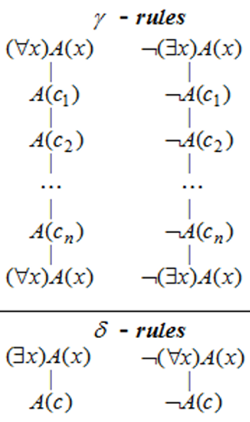
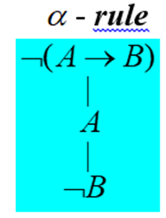
Ua = (∃x)(∀y)P(x,y)→(∀y)(∃x)P(x,y)
(∃x)(∀y)
¬Ua = ¬((∃x)(∀y)P(x,y)→(∀y)(∃x)P(x,y)) (1)
| α-rule for (1)
(∃x)(∀y)P(x,y) (2)
|
¬((∀y)(∃x)P(x,y)) (3)
| δ-rule for (3), c0 - a new constant
¬((∃x)P(x,c0)) (4)
| δ-rule for (2), c1 – a new constant
(∀y)P(c1,y) (5)
| γ-rule for (5), c0 used for instantiation
P(c1,c0)
|
(∀y)P(c1,y) (copy of formula (5))
| γ-rule for (4), c1 used for instantiation
¬P(c1,c0)
|
¬((∃x)P(x,c0)) (copy of formula (4))
⊗ closed branch

Slide 8
Ub = (∀y)(∃x)P(x, y)→ (∃x)(∀y)P(x, y) ¬Ub = ¬((∀y)(∃x)P(x ,y)→ (∃x)(∀y)P(x, y))
¬Ub = ¬((∀y)(∃x)P(x ,y)→ (∃x)(∀y)P(x, y)) (1)
| α-rule for (1)
(∀y)(∃x)P(x ,y) (2)
|
¬((∃x)(∀y)P(x, y)) (3)
| γ-rule for (2), c0 – a new constant
(∃x)P(x, c0) (4)
|
(∀y)(∃x)P(x ,y) (5) (copy of formula (2))
| δ-rule for (4), c1 - a new constant
P(c1,c0)
| γ-rule for (3), c1 used for instantiation
¬((∀y)P(c1, y)) (6)
|
¬((∃x)(∀y)P(x, y)) (7) (copy of formula 3)
¬((∃x)(∀y)P(x, y)) (7) (copy of formula 3)
| δ-rule for (6), c2 - a new constant
¬P(c1, c2)
| γ-rule for (5), c2 used for instantiation
(∃x)P(x, c2) (8)
|
(∀y)(∃x)P(x ,y) (9) (copy of formula (2))
| δ-rule for (8), c3 - a new constant
P(c3,c2)
| γ-rule for (7), c3 used for instantiation
¬((∀y)P(c3 y)) (9)
|
¬((∃x)(∀y)P(x, y)) (10) (copy of formula 3)
| δ-rule for (9), c4 - a new constant
¬P(c3, c4)
…

Slide 9
Conclusions
The semantic tableaux of Ub is infinite, and as such we cannot decide upon the validity of Ub.
An interpretation which falsifies Ub is I = <D,m>, where the domain D=N is the set of all natural numbers and m(P) : NxN -> {T,F}, m(P)(x,y) : “ x is the successor of y”
The formula Ub = (∀y)(∃x)P(x, y)→ (∃x)(∀y)P(x, y) is evaluated under the interpretation I as:
(∀y)_{y∊ N}(∃x)_{x∊N} “x is the successor of y” → (∃x) _{x∊N}(∀y) _{y∊ N} “x is the successor of y”
And can be translated as:
“Every natural number has a successor implies that there is a unique x such that x is the successor of every natural number” which is obviously false, so Ub is not a tautology.
We found thus far that Ua is a tautology (its negation has a closed semantic tree) and Ub is not, so U2 is not a tautology either.

